Slide 1

Characterizing Smart home IoT Traffic in the wild
IoTDI 2020
M. Hammad Mazhar
Zubair Shafiq
@HmdMazhar
@zubair_shafiq
The University of Iowa
Notes:
Hi everyone, I’m Hammad Mazhar from the University of Iowa and today I will be presenting our work, ‘Characterizing Smart Home IoT Traffic in the Wild’ where we study smart home IoT traffic from actual homes.
With ~1400 million devices expected to ship in 2023 and an estimated contribution of nearly half of all IoT traffic in 2022, smart home IoT has become ubiquitous in everyday life

Slide 2
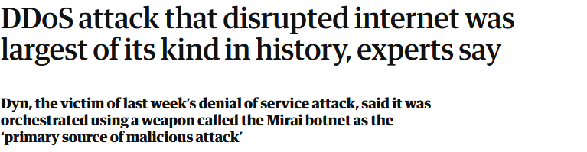
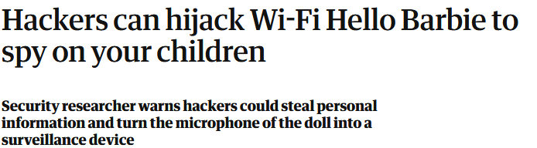
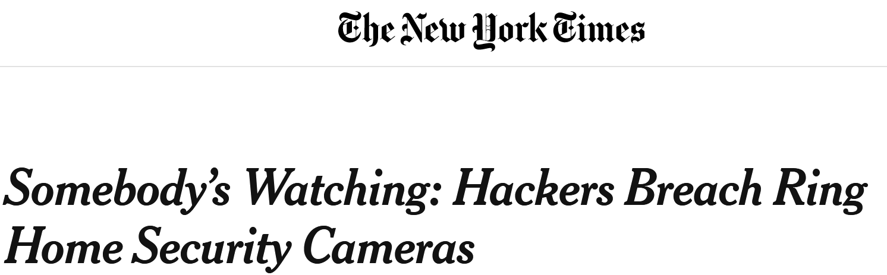
Smart Home IoT – A Target
Notes:
This growth also makes Smart Home IoT a valuable target for malicious purposes.
Over the past few years we have also seen a variety of attacks that leverage vulnerabilities in smart home IoT devices, turning them into botnets for DDoS attacks (as with the Mirai botnet) or privacy invasion tools (such as with the Ring Camera and Hello Barbie doll).
Such incidents have driven researchers to study Smart Home IoT to tackle challenges in security and privacy.

Slide 3
Prior Work – Limitations and Challenges
Fragmentation
Smart TVs [PETS ‘20], Alexa [AsiaCCS ‘19].
Non-representative
Testbed environments [IMC ’19, S&P ’19].
Scale
Limited number of devices [PETS ’17, PETS ’19].
Notes:
However, such research has run into challenges which limit the effectiveness of their solutions.
First, fragmentation in the smart home IoT ecosystem limits the categories and types of devices researchers have studied. Past studies have focused on specific types of devices such as Smart TVs or Alexa Voice Assistants.
Second, Prior work on smart home IoT has been conducted in non-representative environments, using testbed conditions where interactions are controlled based on research purpose. Under real-world conditions, users may interact with smart home IoT devices in non-conventional ways.
Third, prior work has been unable to study smart home IoT at scale. Due to cost and space constraints, researchers are limited to studying a small amount of smart home IoT devices, reaching at best 20-30 devices.

Slide 4

Our Contributions
Fragmentation
Leverage the home gateway as the vantage point.
Non-representative
Study smart home IoT behavior in the wild.
Scale
Study over 200 homes.
Notes:
Our work tackles these challenges in various ways.
For fragmentation, our study leverages the home gateway as the vantage point. This allows us to cover the diversity of the smart home IoT ecosystem.
To capture smart home IoT behavior in real conditions, we study smart home IoT behavior in the wild. By partnering with Minim (a smart home and WiFi management platform), we were able to instrument gateways capable of monitoring smart home IoT traffic from actual homes.
Partnering with Minim also allows us to study smart home IoT behavior at scale, by covering over 200 homes through their instrumented gateways.

Slide 5
Data Collection - Instrumentation
Collect Netflow-style flow records at WAN interface of home gateway.
Device identification using DHCP, SSDP and UPnP traffic.
Anonymized data collection (no public IP addresses or device MAC addresses) with user consent.
Notes:
We now highlight the instrumentation of the home gateway for collecting data on smart home IoT traffic.
As indicated earlier we utilized Minim’s platform of home gateway routers for collecting this data.
These routers are instrumented to collect Netflow-style flow records at the WAN interface (which is the interface that connects to the ISP) of the home gateway.
Whenever a device is connected to the home gateway, it is identified using expert rules that utilize DHCP, SSDP and UPnP traffic. This allows to identify if a smart home IoT device is connected.
An important point to note here is that all data collection is anonymized. No public facing IP addresses or MAC addresses are collected and all data is collected with consent from the user.

Slide 6
Data Statistics
1230 devices observed across 220 homes over 19-day period in February 2018.
240 IoT, 958 non-IoT.
66 unique IoT device types (make and model) across 8 categories.
Smart TVs, Cameras, Speakers, Assistants, Game Consoles, Home Automation, Work Appliances and Health/Wearables.
Notes:
Based on user consent, we collect data from 220 homes over a 19 day period in February 2018. During this period, we observed 1230 devices that connected to the instrumented gateways.
240 devices fall under our IoT umbrella, while 958 did not. 32 devices could not be directly identified by the device identification system.
We observed 66 unique IoT device types (make and model) in our data collection. These types can be grouped into 8 categories which describe their basic functionality, such as Smart TVs, camer

Slide 7
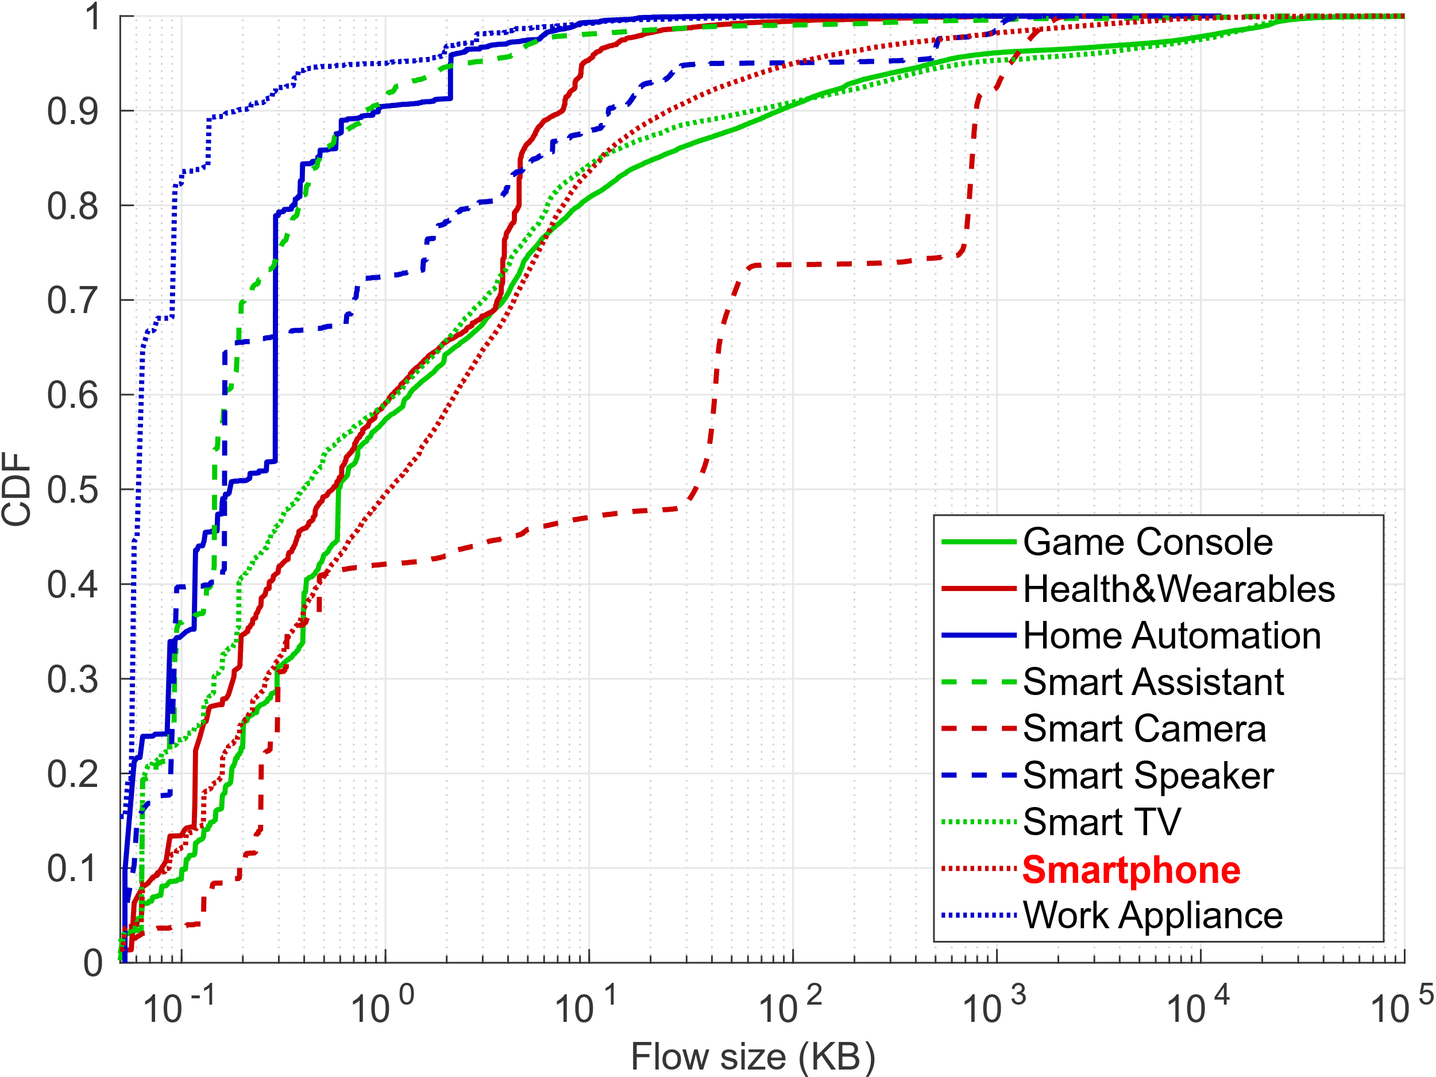
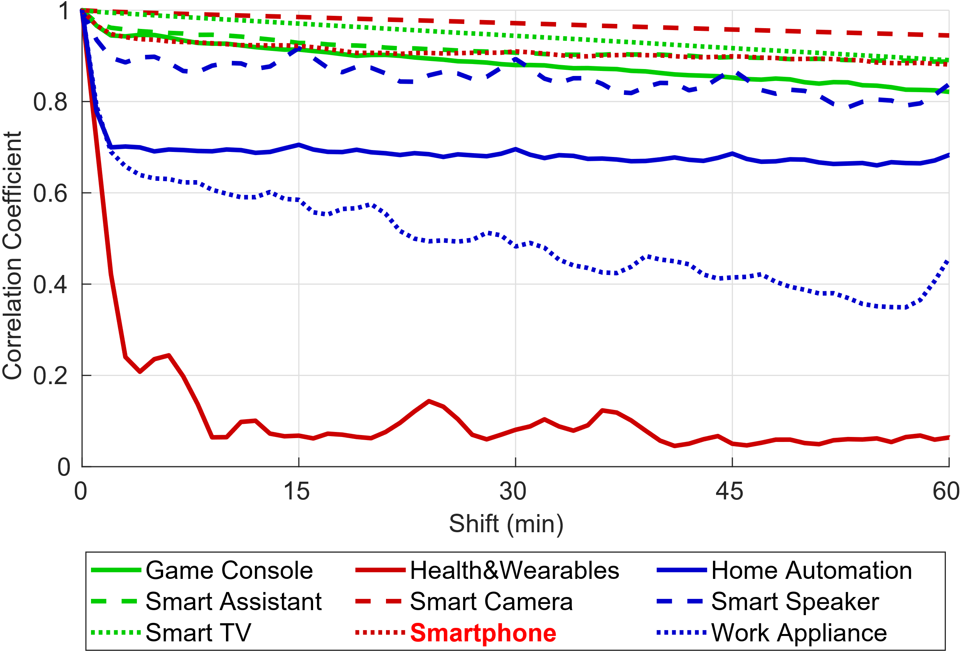
Characterizing Smart Home IoT traffic
Three dimensions:
Volumetric
Temporal
Destination
Device functionality determines traffic characteristics in Smart Home IoT.
Sub-KB control flows.
70-90% of traffic to Amazon, Google owned AS (higher backend centralization compared to 31% of overall Web).
Sub-hour ‘heartbeat’ traffic.
Notes:
We characterize smart home IoT traffic across 3 dimensions; volumetric, temporal, and destination.
We highlight some interesting points from this characterization.
For volumetric, we primarily study flow distributions across device categories. A key point we note in these distributions is the prevalence of sub-KB flows, which correspond to control traffic unique to smart home IoT traffic.
Under temporal, we study time series distributions at hourly and sub-hourly levels. At the sub-hour level, we note the presence of sub-hour periodic traffic, which upon further investigation was revealed to be ‘heart-beat’ traffic unique to smart home IoT.
Finally, we study destinations at the Autonomous System and domain level. An interesting finding at the AS level was that for many device categories, 70-90% of traffic was directed to Amazon or Google owned AS es. Despite the front-end fragmentation of the smart home IoT ecosystem, the back-end is much more centralized compared to general web traffic.
Along with these observations, the primary conclusion from this study is that device functionality plays a pivotal role in smart home IoT traffic.

Slide 8
Security/Privacy Issues in Smart Home IoT
Highlight current issues and their implications.
4 case studies:
Security via Access Control.
Advertising/Tracking.
Unencrypted Traffic – Devices vulnerable to HTTP snooping.
Use of public DNS services – use of Google DNS prevalent.
Notes:
Along with the characterization of smart home IoT traffic, we also explore smart home IoT traffic with respect to security and privacy concerns.
We highlight 4 of these concerns through case studies and their implications.
In the interest of time, I will only go through the first 2 of these in detail, namely Security via Access Control and Advertising and Tracking in Smart home IoT.
In the case of Unencrypted traffic, we note certain devices accessing the Internet over HTTP, which leaves them vulnerable to HTTP eavesdropping.
We also noted the use of public DNS services, ignoring the local DNS resolver. Google DNS was the prevalent service used in this case, pointing towards more centralization.

Slide 9
Securing Smart Home IoT via Access Control
Prior work recommends some form of Internet Access Control for smart home IoT.
Manufacturer Usage Description (MUD – RFC 8520) by device manufacturers.
Research tools to build MUDs based on device traffic – MUDgee (IoTS&P ‘18).
Notes:
Based on the properties of smart home IoT traffic, researchers have proposed some form of Internet Access Control for smart home IoT devices to prevent then from accessing Internet hosts unrelated to their functionality and to mitigate damage in the case of compromise.
To this end, Manufacturer Usage Descriptions have been recently standardized in RFC 8520. These descriptions are to be provided by device manufacturers, laying out how a specific smart home IoT device is expected to access the Internet. Home gateways can then use this information to generate Access Control Lists (ACLs) for installed devices in the home.
Since MUDs are not currently provided by smart home IoT manufacturers, we rely on tools such as MUDgee built by researchers to build these MUDs.

Slide 10
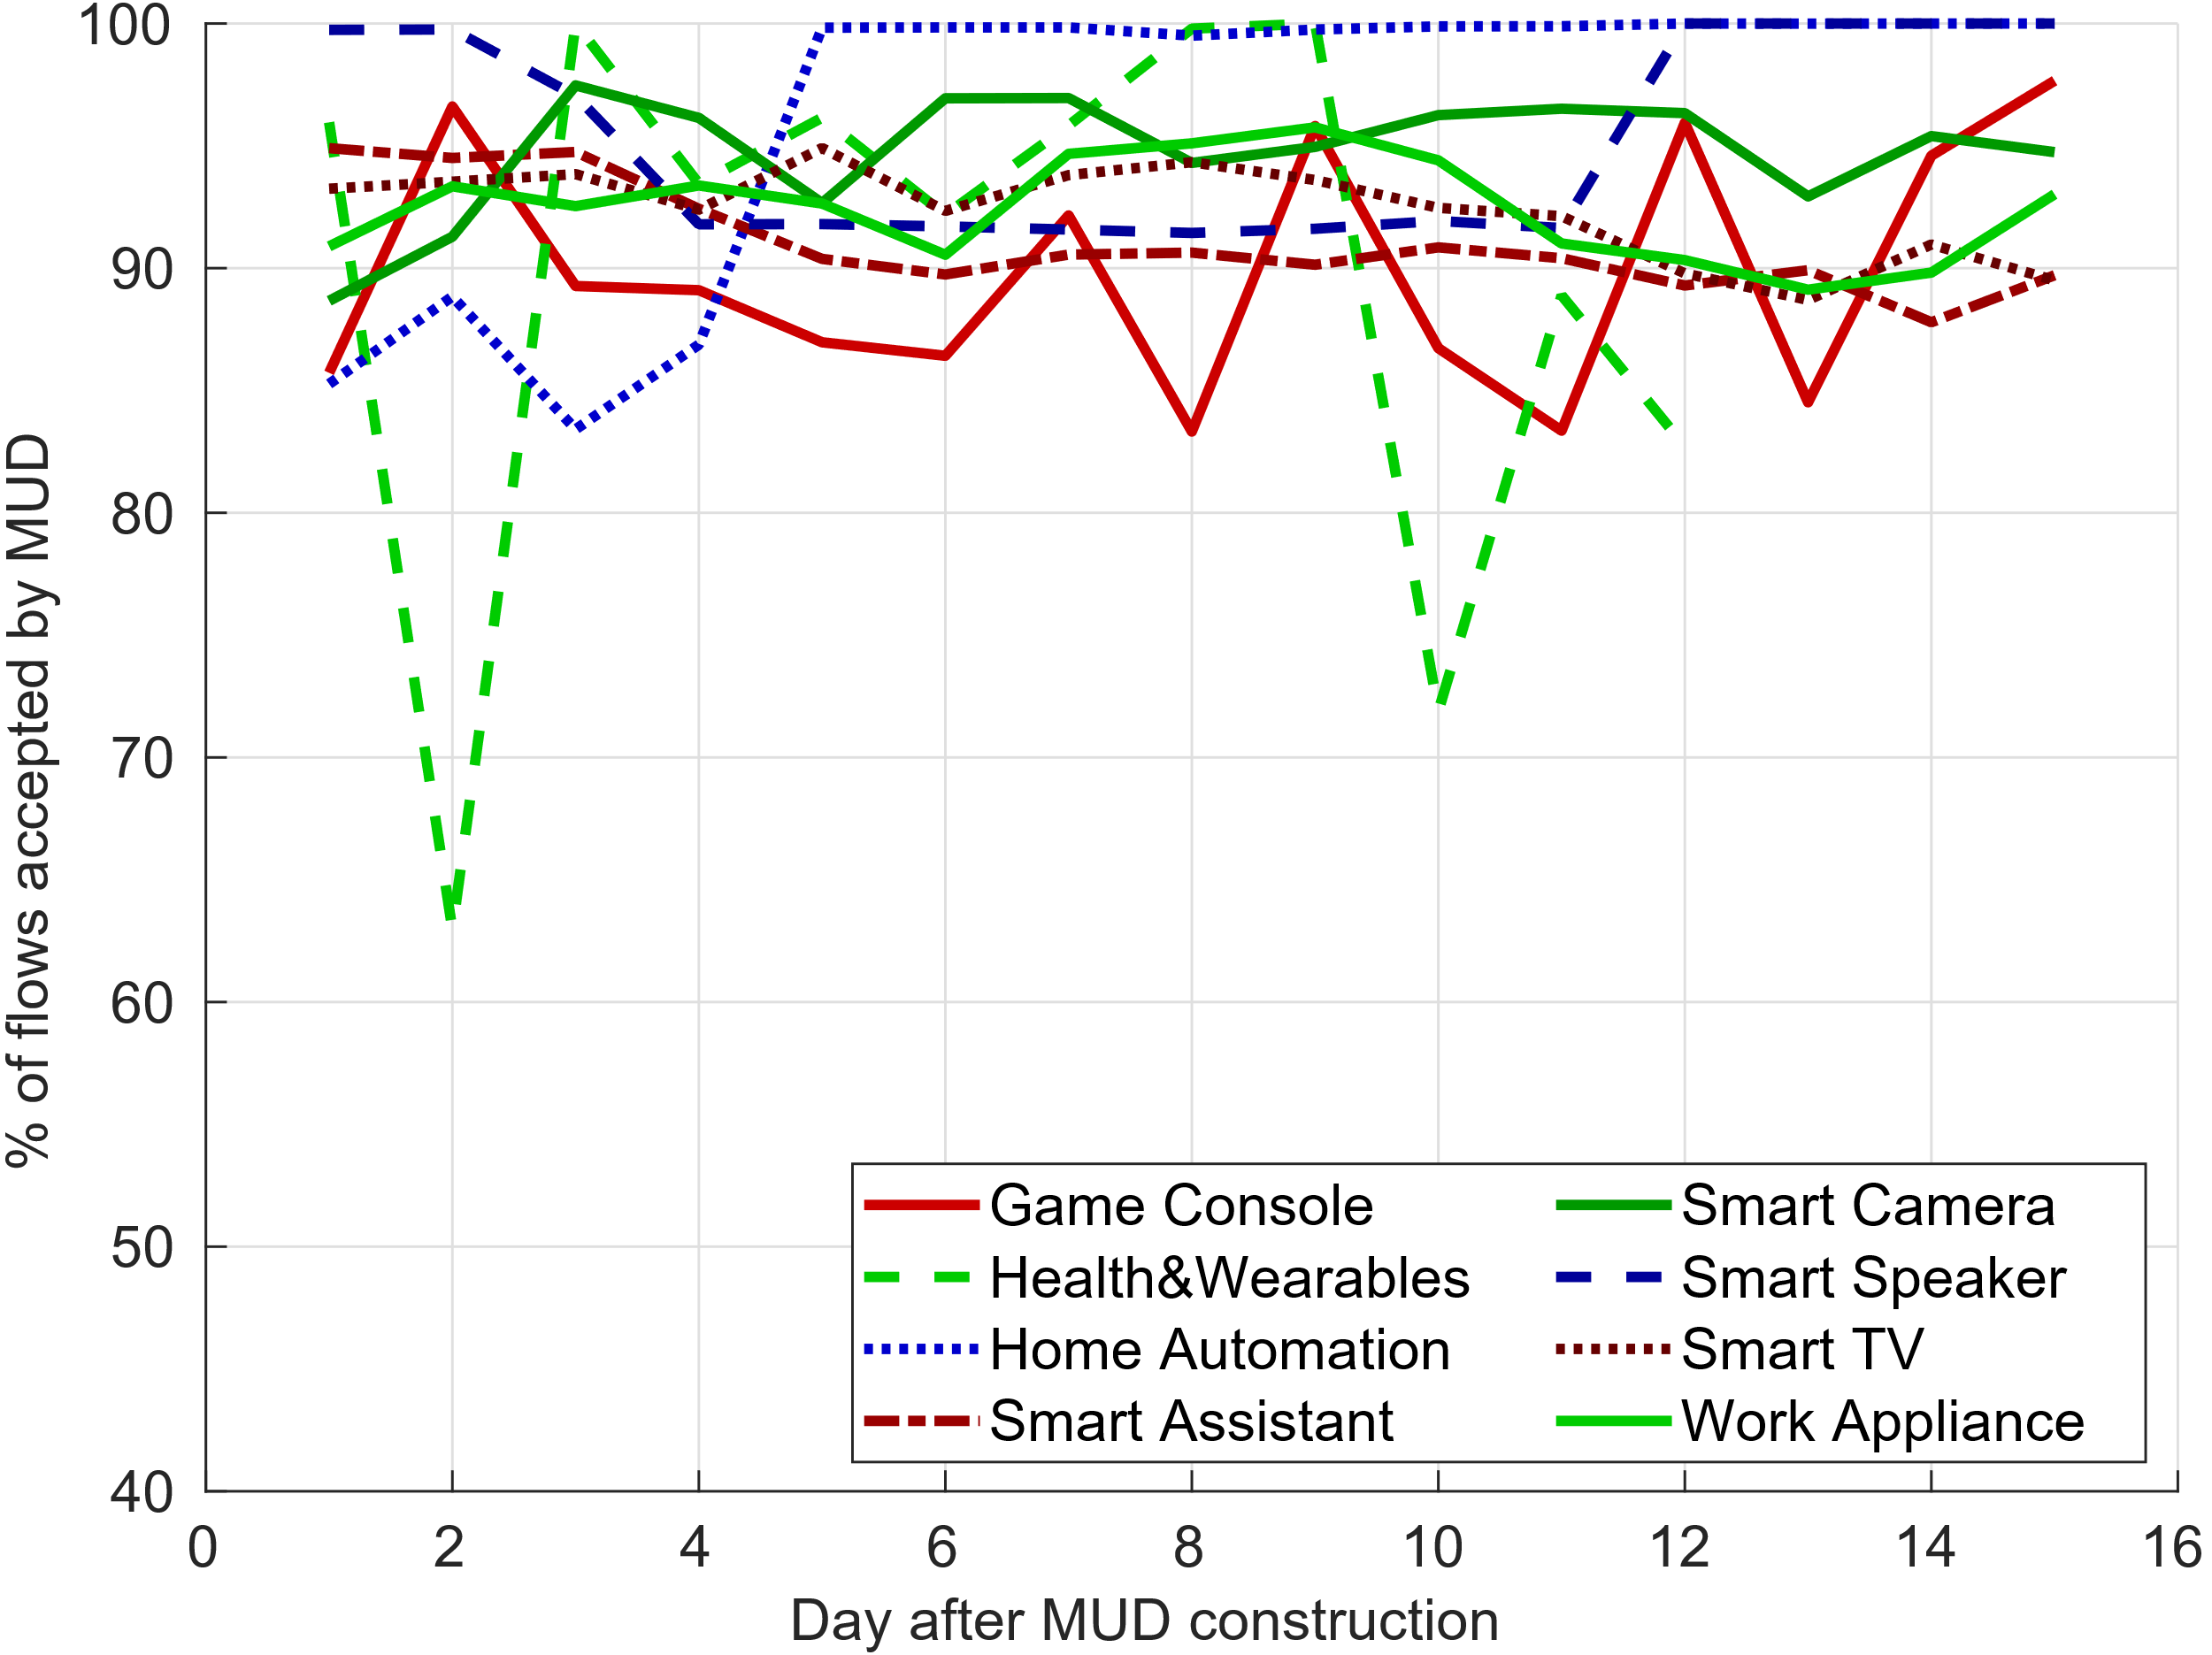
Securing Smart Home IoT via Access Control
First 72 hours of traffic to build MUD, then test for acceptance.
High acceptance rates for MUD-based ACL
MUDs can help in access control, but require more work to account for dynamic traffic.
Drops due to unseen traffic
Notes:
In our experiment, we use the first 72 hours of traffic for individual devices to generate MUDs, create ACLs from them, then test subsequent traffic for acceptance, shown in this plot.
The X axis denotes the amount of time the traffic is from the generated MUD, while the Y axis shows the average % of flows accepted by the MUD for each device category.
We note that acceptance rates generally tend to be high, between 85-95%% for most categories, such as Home Automation, Smart Speakers and Smart Cameras.
We also note that some categories saw drops in acceptance such as with Health & Wearable devices. Upon investigation, we see these to be due to Apple Watches, which accessed domains unseen during the training phase.

Slide 11
Security/Privacy Issues in Smart Home IoT
Highlight current issues and their implications.
4 case studies:
Security via Access Control – Feasible, account for dynamic traffic
Advertising/Tracking
Unencrypted Traffic – Devices vulnerable to HTTP snooping.
Use of public DNS services – use of Google DNS prevalent.
Notes:
Along with the characterization of smart home IoT traffic, we also explore smart home IoT traffic with respect to security and privacy concerns.
We highlight 4 of these concerns through case studies and their implications.
In the interest of time, I will only go through the first 2 of these in detail, namely Security via Access Control and Advertising and Tracking in Smart home IoT.
In the case of Unencrypted traffic, we note certain devices accessing the Internet over HTTP, which leaves them vulnerable to HTTP eavesdropping.
We also noted the use of public DNS services, ignoring the local DNS resolver. Google DNS was the prevalent service used in this case, pointing towards more centralization.

Slide 12
Advertising/Tracking in Smart Home IoT
Detect ad/tracking hosts using Pi-Hole’s block lists.
5.9% of Smart TVs unique hosts were ads/tracking, followed by 3.1% of Game Consoles and 2.9% Smart Assistants.
DoubleClick and Google Syndication domains prominent.
Online Tracking has reached smart home IoT and requires more study into its effects.
Notes:
Under destination characteristics of smart home IoT traffic, we saw the presence of domains what are associated with tracking behavior. To further investigate this behavior, we analyze smart home IoT traffic using Pi-Hole’s blocking lists. Pi-hole is a DNS-level tool for blocking advertising and tracking connections on devices.
When we analyze the unique domains accessed by smart home IoT device categories, we find that Smart TV’s are most prevalent in accessing such hosts at 5.9%, followed by Game Consoles (3.1%) and Smart Assistants (2.9%). A key point to note here is that this represents a low bound on possible ad/tracking hosts since Pi-hole lists are not Specialized to smart home IoT.
Amongst the top ad/tracking domains accessed by these categories, we note that Google-owned domains, such as DoubleClick and GoogleSyndication are prominent, including categories which do not have any devices manufactured by Google. This implies that Google has the capability to track users across smart home IoT devices.
Given these results, it is safe to say that tracking has reached smart home IoT. Given past work on online tracking on web browsers and cellphones, similar work needs to be initiated on smart home IoT.

Slide 13
Security/Privacy Issues in Smart Home IoT
Highlight current issues and their implications.
4 case studies:
Security via Access Control – Feasible, account for dynamic traffic
Advertising/Tracking – Present in certain devices, major players.
Unencrypted Traffic – Devices vulnerable to HTTP snooping.
Use of public DNS services – use of Google DNS prevalent.
Notes:
Along with the characterization of smart home IoT traffic, we also explore smart home IoT traffic with respect to security and privacy concerns.
We highlight 4 of these concerns through case studies and their implications.
In the interest of time, I will only go through the first 2 of these in detail, namely Security via Access Control and Advertising and Tracking in Smart home IoT.
In the case of Unencrypted traffic, we note certain devices accessing the Internet over HTTP, which leaves them vulnerable to HTTP eavesdropping.
We also noted the use of public DNS services, ignoring the local DNS resolver. Google DNS was the prevalent service used in this case, pointing towards more centralization.

Slide 14
Conclusions and Implications
Device functionality influences traffic behavior.
Device identification, activity identification, MUD generation.
Smart Home IoT backend centralization.
Market monopolization, surveillance, single point of failure.
Advertising and Tracking in Smart Home IoT.
Requires more study, solutions catered to smart home IoT.
Notes:
I conclude this talk by laying down key findings and their implications.
One, device functionality plays a pivotal role in smart home IoT traffic behavior. Based on our findings, traffic patterns unique to specific IoT device categories can be leveraged for device identification and their relation with human activity can be leveraged for activity identification. Furthermore, these findings can be used to improve tools for generating MUDs for smart home IoT devices by capturing characteristics unique to specific device types.
Two, the smart home IoT ecosystem backend is becoming centralized with major players providing the bulk of services. This has implications in market share monopolization, as well as redundancy issues. Manufacturers must ensure that their products are resilient in the case of backend failure
Three, advertising and tracking entities have started to target smart home IoT. This has major privacy implications as users may not be aware of how their data is being collected. Our results are likely an underestimate of actual advertising and tracking since the filters available are not specialized for smart home IoT. Further study is required to not only capture the full extent of these activities but also build solutions towards preventing such tracking on these devices as done for web browsing and smartphones.

Slide 15
Questions
Twitter: @HmdMazhar
Email: muhammadhammad-mazhar@uiowa.edu
Website: cs.uiowa.edu/~mmazhar
IoTDI 2020

Slide 16
Overview – Smart Home IoT
1396 million devices expected to ship worldwide in 2023 (from 840 million in 2019). [IDC]
Smart home IoT expected to contribute 48% of all IoT traffic by 2022. [Cisco]
Smart home IoT devices have become ubiquitous in everyday life.
Notes:
Over the past couple of years, smart home IoT has seen tremendous growth.
[Point 1]
Subsequently, the traffic generated by these devices is fast becoming a significant part of world Internet traffic.
[Point 2]
Hence, [Point 3]

Slide 17

Volumetric Characteristics of Smart Home IoT
Flow distributions across device categories
Low-volume control traffic.
High volume flows from accessing Web content or video data
Device functionality determines volumetric characteristics.
Notes:
We study the volumetric characteristics of smart home IoT traffic here by looking at flow distributions across IoT data categories.
This figure shows the cumulative distribution functions of flow sizes for different smart home IoT categories, with Smartphones as a baseline. The X-Axis shows log-scale flow sizes in KB, and the Y-Axis shows the cumulative distribution.
We note that device categories such as smart assistants, work appliances, and home automation mostly generate less than a KB per flow. Such devices primarily use the internet for sending control data, such as accessing weather reports or ‘heartbeat’ messages.
On the other hand, we see device categories such as Smart TVs, Game Consoles and Smart Cameras generating significantly higher flows. The core functionality of such devices has them accessing Web Content such as video or uploading video data for backup as in the case of smart cameras.
Overall, our study showed that volumetric characteristics are dependent on device functionality.

Slide 18
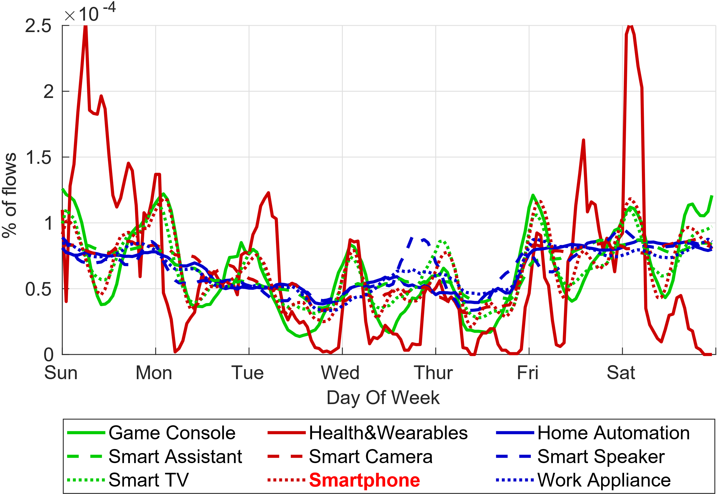
Temporal Characteristics of Smart Home IoT
Time series distributions.
Diurnal Traffic Patterns for explicit user interactions
Device functionality determines temporal characteristics.
Non-Diurnal Traffic with sub-hour periodicity
Notes:
For studying the temporal characteristics of smart home IoT, we look at time series distributions of traffic.
Here we show hourly time series distributions for smart home IoT categories across the days of the week. The X-axis shows the time of day while the Y-axis shows the % of flows observed for the category.
We observe daily diurnal traffic patterns for specific device categories such as Game Consoles, Smart TVs and Health/Wearables. Common across these device categories is that their functionality requires explicit user interactions such as accessing Web video or downloading video game data.
We also note that certain device categories do not exhibit such daily patterns such as Home Automation, Smart Cameras and Smart Speakers. These devices are often designed to not require explicit user interactions, such as monitoring environments for changes. On closer inspection, such categories instead show sub-hour periodicity through ‘heartbeat’ traffic.
In general, device functionality plays an important role in temporal characteristics of smart home IoT traffic.

Slide 19
Destination Characteristics of Smart Home IoT
Autonomous System (AS) and domain levels.
70-90% of traffic goes to Amazon, Google owned AS, reflecting centralization at back-end.
Domains primarily correspond to device functionality (e.g. pandora.com for smart speakers).
Domains associated with tracking also observed, particularly for smart TVs (samsungacr.com).
Destinations depend upon device functionality.
Notes:
We also explore the destination characteristics of smart home IoT traffic. We do this in two levels, at the Autonomous System level, and at the domain level.
At the autonomous level, we note that certain AS-es were unique to certain categories such as HP for Work Appliances and Apple for Wearables. However, a key point we note is that 70-90% of all traffic for most categories went to an Amazon or Google owned AS. Both companies provide cloud storage and processing services such as AWS and Google Cloud. While devices made by these companies would be expected to utilize these services, other manufacturers seem to have adopted these services for their IoT backends instead of rolling out their own. In short, while the smart home IoT ecosystem is fragmented on the front-end, it is centralized on the back-end.
On the domain level, top domains for smart home IoT categories correspond to device functionality. For instances, smart speakers accessed pandora.com (a music streaming service) frequently, while game consoles would access xboxlive.com and smart TVs would access netflix.com. However we noted the presence of domains associated with tracking, such as samsungacr.com for smart TVs.

Slide 20
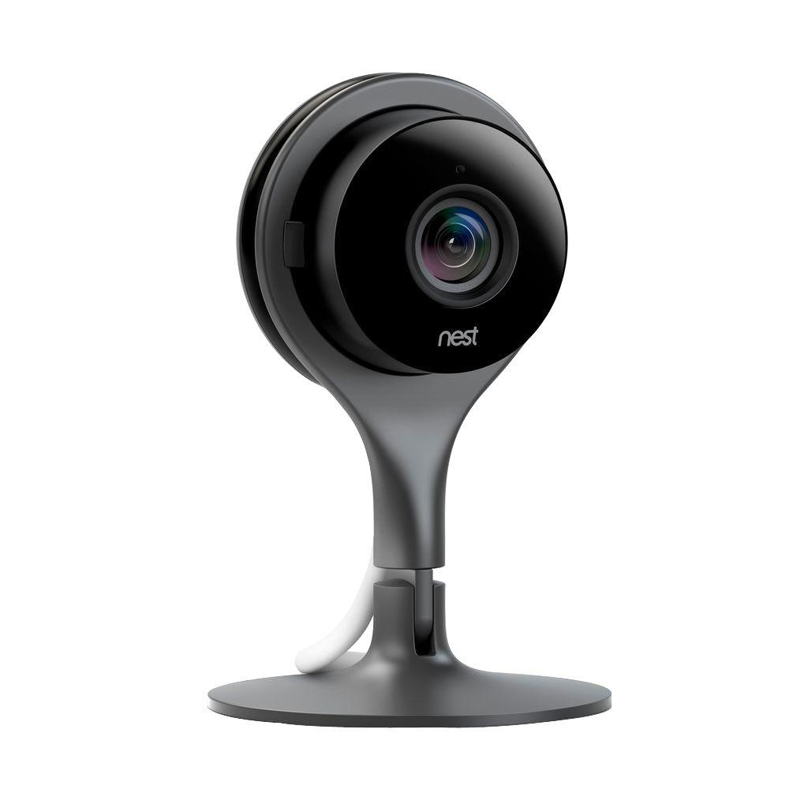
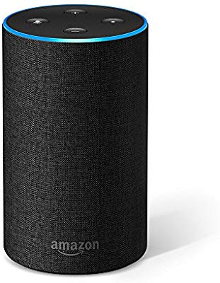

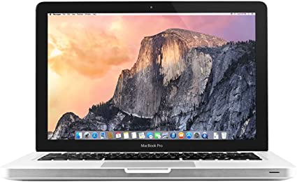
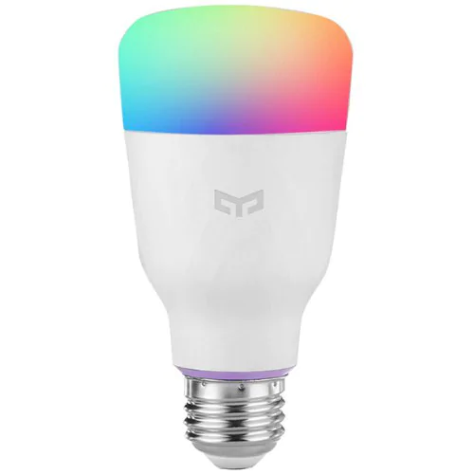
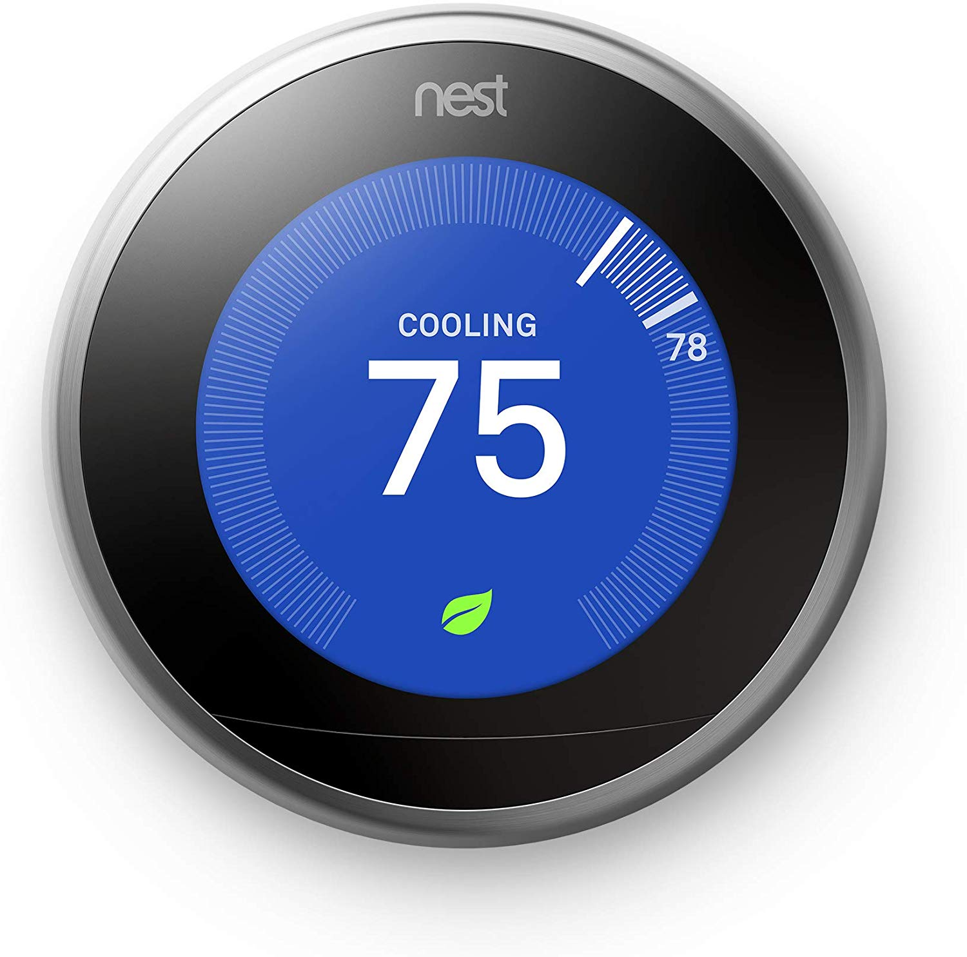
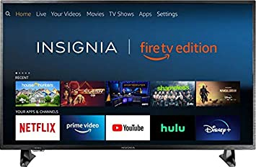
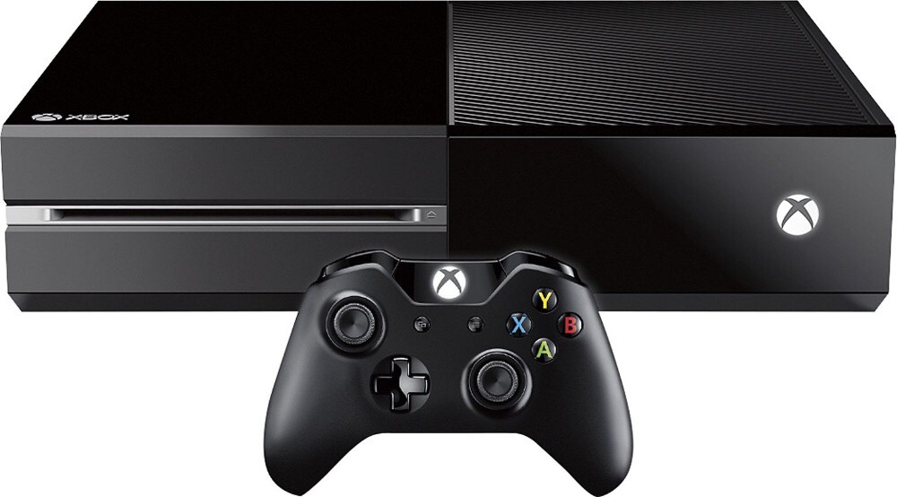
Smart Home IoT – Categorization
Single-purposed IoT Devices
‘IoT-ish’ Devices
Multi-purposed non-IoT Devices
IoT – 8 categories
Non-IoT – 4 categories
Notes:
Before we move on, it is important to understand what we consider as a smart home IoT device.
Our work considers Internet-connected devices at home to lie on a spectrum based on their functionality.
On one side, we have devices designed for very specific, singular purposes. Examples of these include home automation devices such as smart bulbs and smart thermostats, and smart cameras.
On the other side, we have multi-purposed devices which perform a variety of tasks such as smartphones, laptops and personal computers.
In the middle of these we have ‘IoT-ish’ devices which can perform multiple tasks, but are close to IoT devices based on their core functionality, such as Smart TVs and Game Consoles.
In our work, we consider single-purposed and ‘IoT-ish’ devices as smart home IoT devices.

Slide 21
Overview – Smart Home IoT Challenges
Smart Home IoT brings new challenges to:
Management (ISPs, homes)
Security (Botnets, vulnerabilities in devices)
Privacy (Sensitive information leakage)
Studying smart home IoT device design, adoption and usage is paramount to tackling these challenges.
Notes:
The growth of Smart Home IoT also brings with it new challenges to:
Management: Where ISPs need to deploy strategies to account for traffic from these devices to ensure network performance, and homes where users need to understand how to manage the smart devices installed in their homes.
Security: We’ve seen how vulnerable smart home IoT devices can be leveraged to build botnets with the Mirai botnet, which attacked Dyn in 2017. The smart home IoT market has generally seen security as an afterthought so vulnerable devices are still being sold and shipped to customers.
Privacy: In a rush to capture the market, manufacturers have often failed to place proper precautions on consumer data, leading to sensitive data leakage often through unencrypted traffic.
These challenges lead us to conclude that studying smart home IoT device design, adoption and usage is paramount to tackling these challenges.

Slide 22
Unencrypted Traffic in Smart Home IoT
Except for Smart Cameras, all IoT categories generated some HTTP (TCP port 80) traffic.
Frequently associated with ad/tracking or manufacturer domains.

Slide 23
Use of Public DNS in Smart Home IoT
Google DNS is most prominent across IoT categories (98% of Smart Assistants used Google DNS).
Hard-coded DNS servers to avoid ISP DNS issues.
Renders DNS level blocking (through Pi Hole) ineffective.

Slide 24
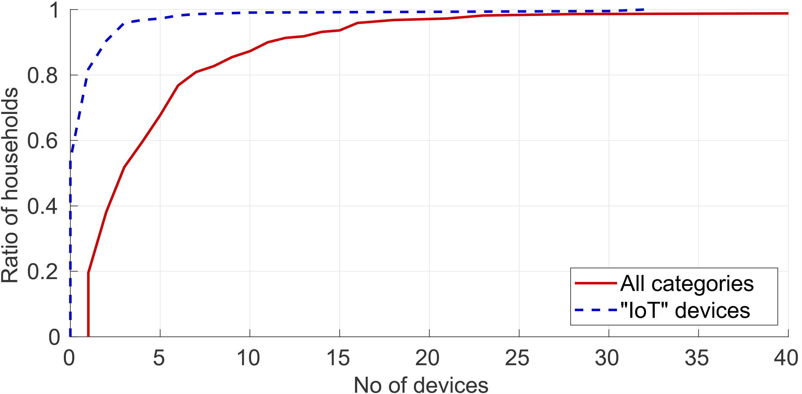
Diversity in Smart Home IoT Adoption
Some homes have more than 25 IoT devices
54% of homes do not have an IoT device.
Large Diversity in Smart Home IoT adoption

Slide 25
Characterization - Conclusions
Functionality defines volumetric, temporal and destination characteristics of smart home IoT traffic.
Despite front end fragmentation, the back end is centralized on general cloud service providers.

Slide 26
Data Collection - Deployment
Partner with Minim – Smart home management platform.
Recruit 220 homes with informed consent of data collection.
Collect data over 19-day period in February ’18.

Slide 27
Studying Smart Home IoT - Challenges
Smart home IoT ecosystem is fragmented.
Smart home IoT behavior is environment-dependent.
Smart home IoT is difficult to study at scale.

Slide 28


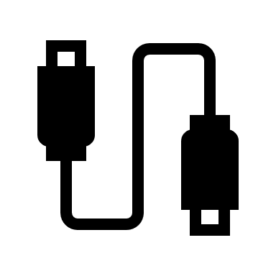

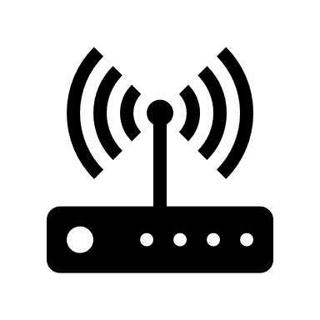
Background - Smart Home
Cloud Services
ISP
Home Gateway

Slide 29
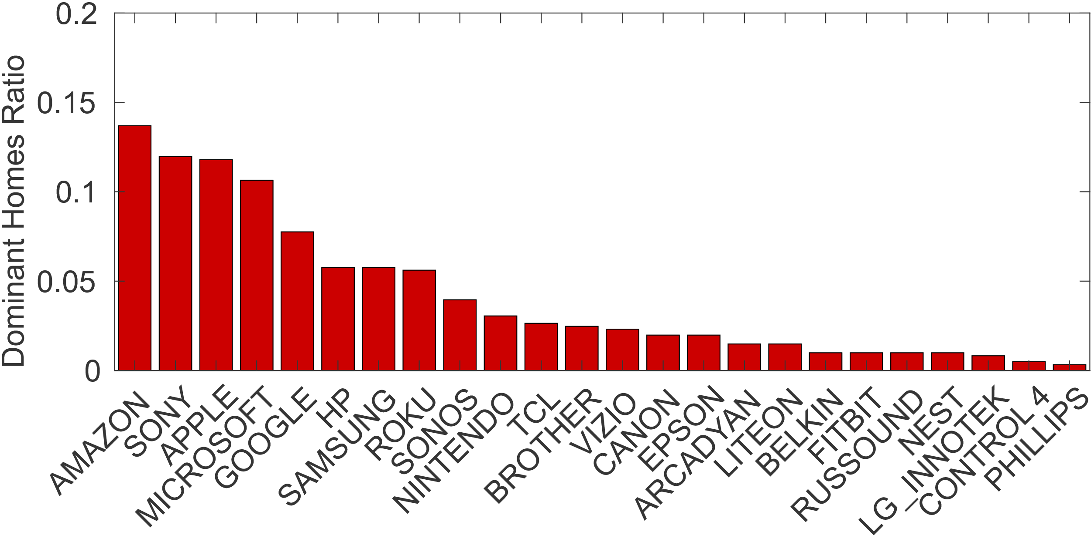
Data Statistics – Manufacturer Dominance
User preference for certain manufacturers of IoT devices
Top 5 Manufacturers by home dominance

Slide 30
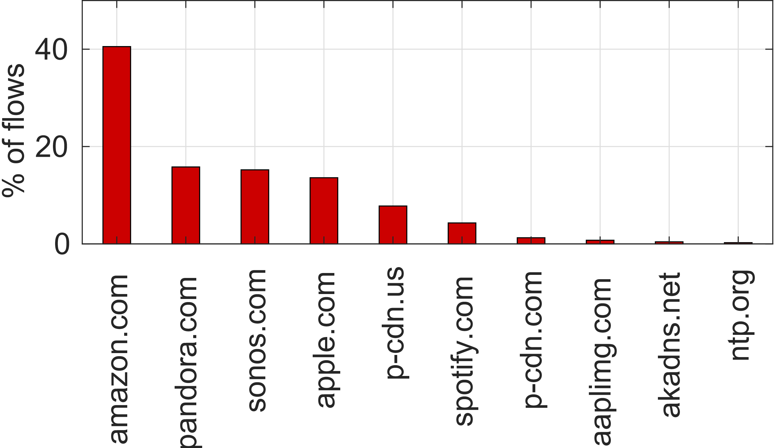
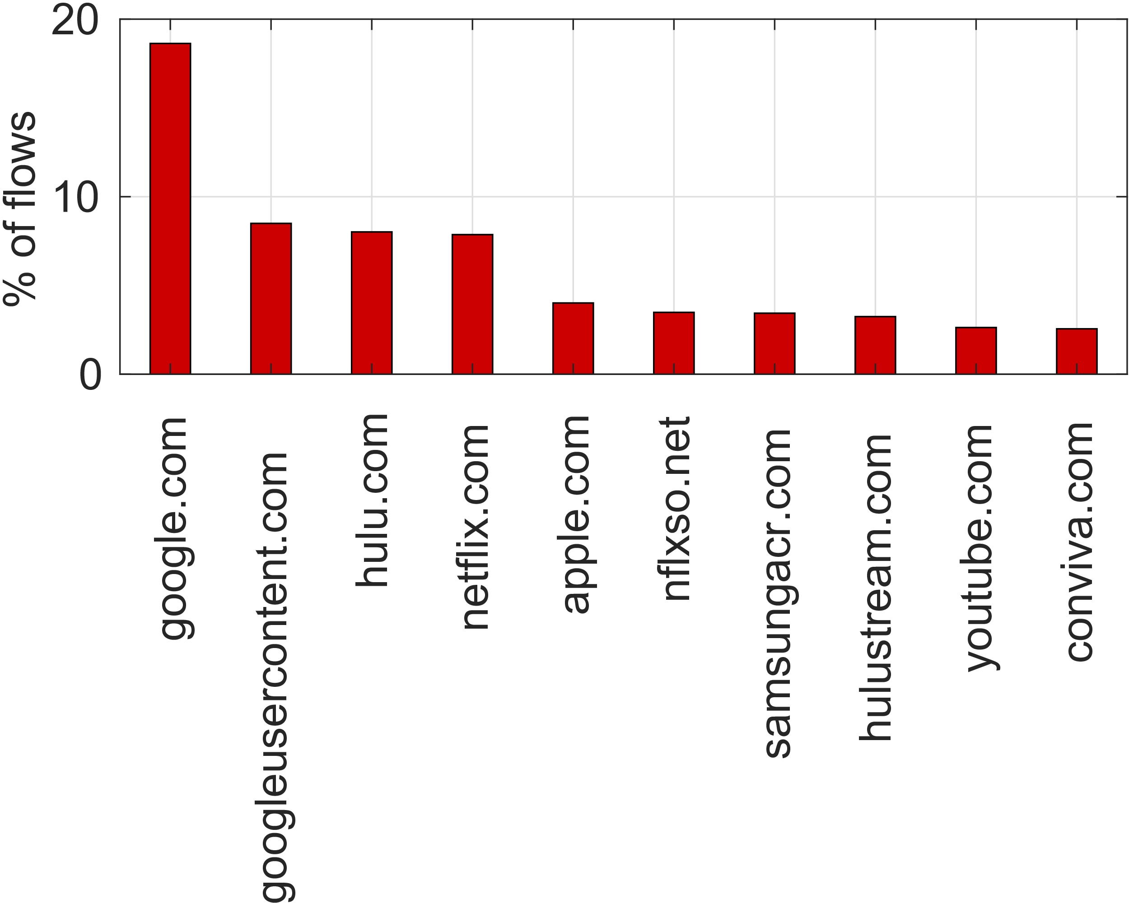
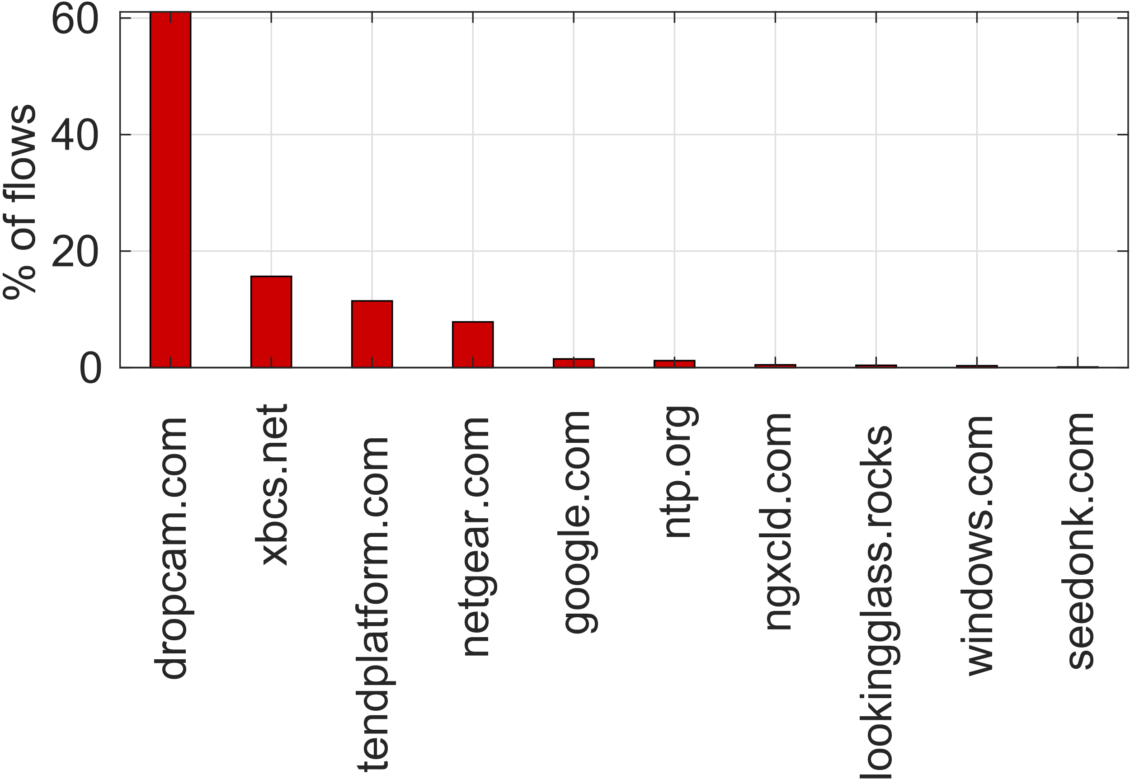
With whom do smart home IoT devices communicate? – Second Level Domains
Top 10 SLDs by ratio of flows per category.
Smart TVs
Smart Speakers
Smart Cameras

